Slide 1
ELECTRONIC DEVICES Presentation
ELECTRONIC DEVICES
NAME: MEHEDI HASAN EMON
Presentation topic: PIV rating in Rectifiers
Course teacher: TAHMIDA ISLAM

Slide 2
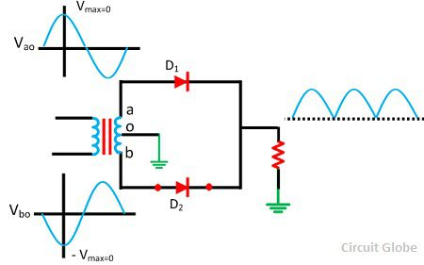
Peak Inverse Voltage (PIV)
Definition: The maximum value of the reverse voltage that a PN junction or diode
can withstand without damaging itself is known as its Peak Inverse Voltage.
However, if the voltage coming across the junction at reverse biased condition
increases beyond this specified value, the junction will get damaged.
As usually, a PN junction or diode is used as a rectifier as shown in the figure above, i.e., it is used to convert AC to DC. Therefore, care should be taken that during the negative half cycle, the peak value of AC voltage should not be more than the rated value of the Peak Inverse Voltage of the diode.

Slide 3
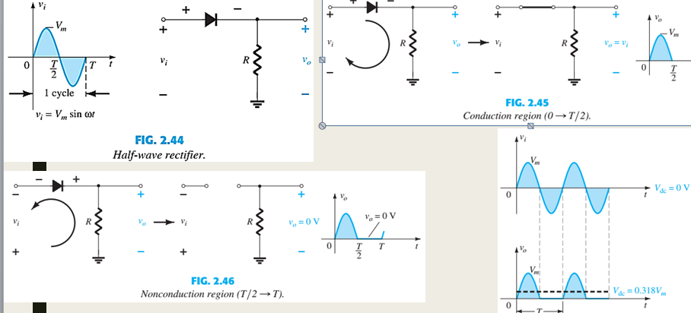
HALF WAVE REGTIFIRE
In Half Wave Rectifier, when the AC supply is applied at the input, a positive half cycle appears across the load, whereas the negative half cycle is suppressed. This can be done by using the semiconductor PN junction diode. The diode allows the current to flow only in one direction. Thus, converts the AC voltage into DC voltage

Slide 4
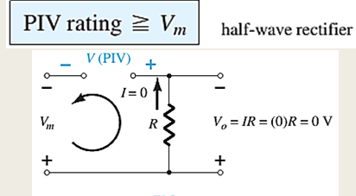

Slide 5
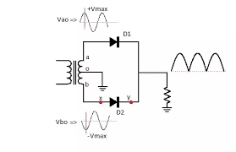
FULL WAVE REGTIFIRE
Peak inverse voltage (PIV) is the maximum possible voltage across a diode when it is reversed-biased.This is in case of full wave center tap rectifier. Peak inverse voltage (PIV) is the maximum possible voltage across a diode when it is reversed-biased.

Slide 6
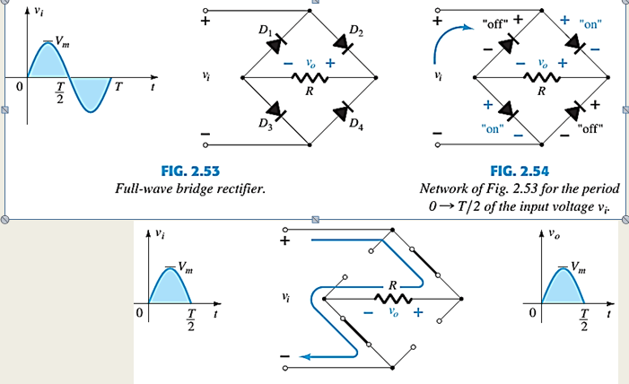

Slide 7
Advantage of full wave rectifier
1.Ripple frequency is two times the input frequency.
2.The output and efficiency of centre tap full wave rectifier are high because AC supply delivers power during both the healvs.
3.For the same secondary Voltage bridge rectifier has double output.

Slide 8
Disadvantage of full wave rectifier
1.It is difficult to locate the centre tap on the secondary winding.
2.The diodes used have high peak inverse voltage.
3.Full wave rectifier require more diodes .
4.When a small Voltage is required to be rectified this full wave rectifier circuit is not suitable.

Slide 9
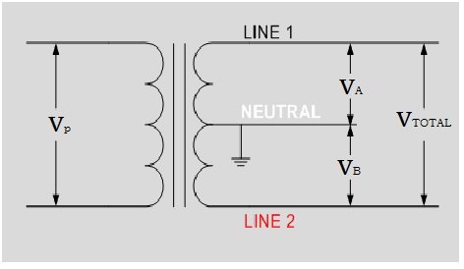
A center-tap transformer is designed to provide two separate secondary voltages, V_{A} and V_{B} with a common connection. This type of transformer configuration produces a two-phase, 3-wire supply. The secondary voltages are the same and proportional to the supply voltage, V_{P}, therefore power in each winding is the SAME
CENTER TRAPPED TRANSFORMENR :

Slide 10
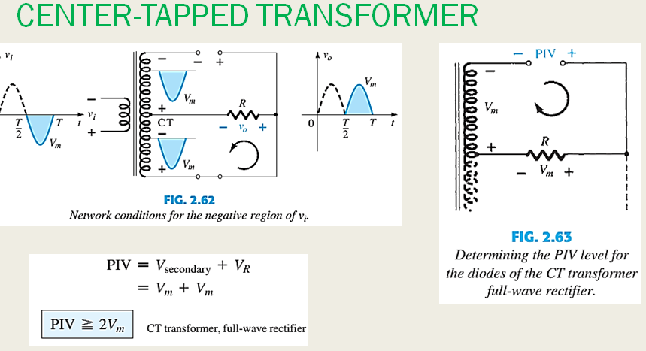

Slide 11
Thank you

